Slide 1
TOUHOU: Darkness of The Night
Final Game Presentation
Rodrigo Toledo Castillo

Slide 2
Agenda
Overview
Rendering System
Gun Update System
Area of Risk and Fixes
Small Video Gameplay

Slide 3
Overview
A vertically scrolling 2D danmaku shooter inspired by the Touhou series.
Key features:
Player movement & shooting
Enemy spawning & bullet patterns
UI with score/lives display
Boss logic and spread patterns

Slide 4
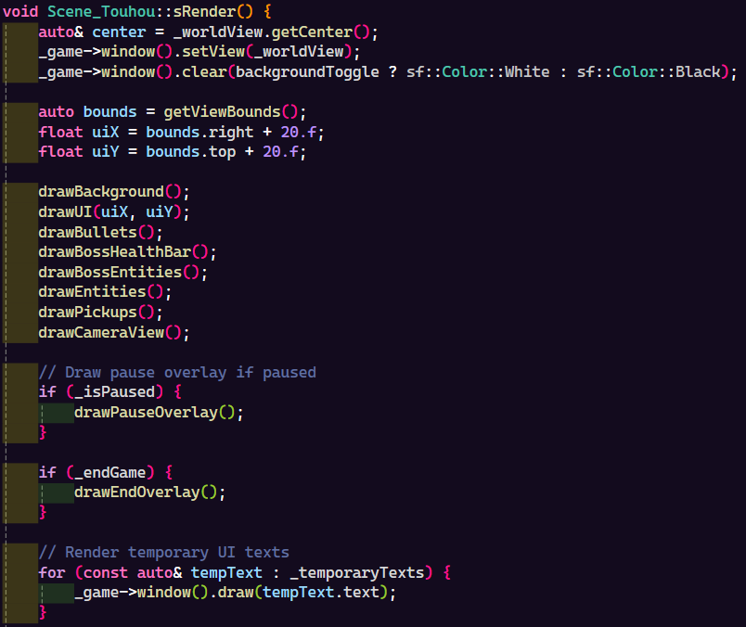
Rendering System (sRender) The central function for all drawing.

Slide 5
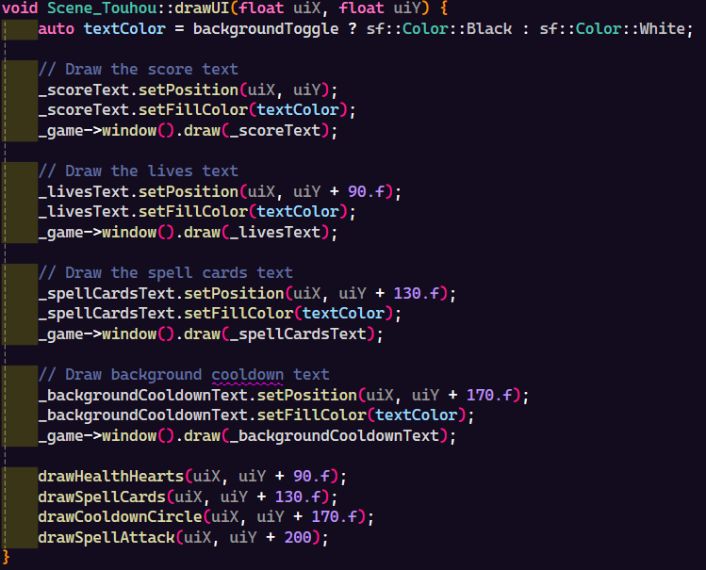
drawUI
Composed of all the player HUD elements

Slide 6
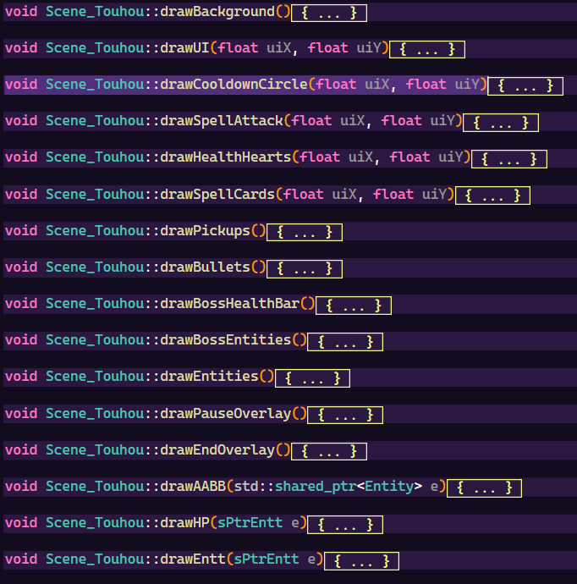
Modular approach:
drawCooldownCircle()
drawHealthHearts()
drawSpellCards()
Etc.
Easy to expand, debug, and modify visual components

Slide 7
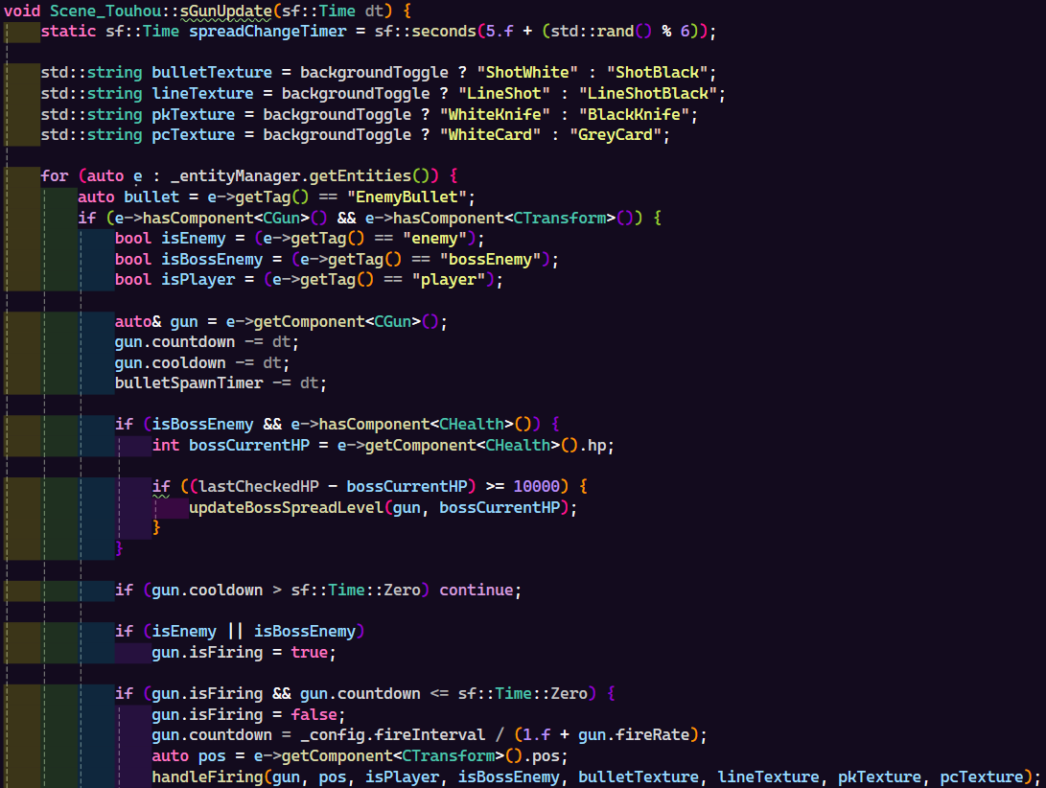
Gun Update System (sGunUpdate)
Rate limiting (fire interval)
uses handleFiring() for modularity.
Handles both player and enemy bullets

Slide 8
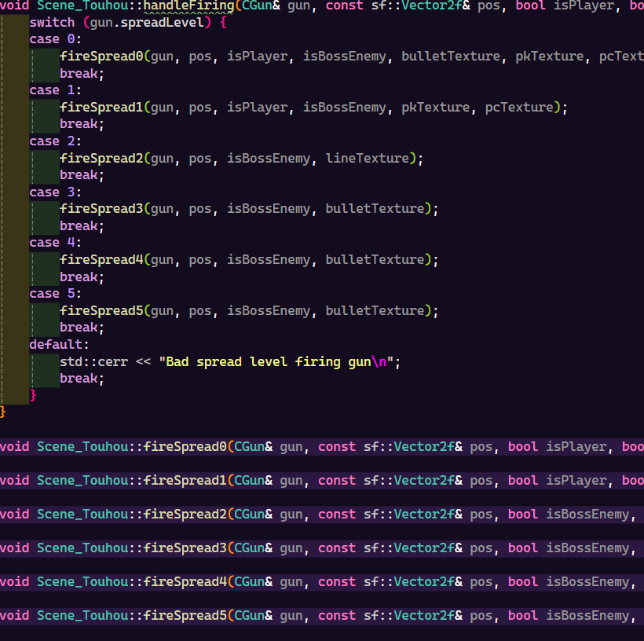
handleFiring() && fireSpreadX()
Each spread function implements a different attack pattern (cone, burst, etc.)
Reusable, extensible
Decouples gun logic from specific bullet designs

Slide 9
Fixes:
Creating a system for passing sprites into bullets, preventing the creation of too many variables.
Optimize the rendering of the game to scale rather than fixed sizes.
Risks:
The current way of implementing sprites into bullets.
The game is made for a full-screen 16:9 ratio.

Slide 10
